Slide 1
POP MUSIC

Slide 2
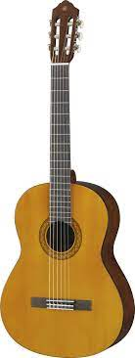
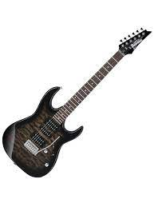
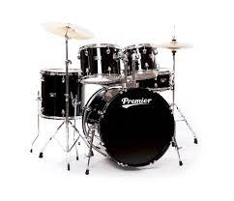
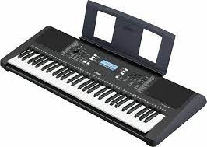
Τhe characteristics of pop music
It is related to light forms of foreign music, or corresponding Greek creations based on the same standards of rhythm and melody (but it should not be confused with the corresponding Greek folk music scene). The term Pop comes from the English term popular, which means popular.
Some of the most common themes it addresses are emotions and romantic love. The main musical instruments used are classical guitar, electric guitar, harmonium and drums.

Slide 3
Τhe categories of pop music
soul pop
contemporary R&B
country pop
pop rock
electronic
dance pop
latin pop

Slide 4
Greek pop singers and Greek pop bands
1] Antique was a Greek band from Sweden that combined Greek pop music and lyrical poems with a Scandinavian/folk dance.
2] Melisses is a Greek musical group consisting of one voice, one bass and one guitar.
Sakis Rouvas: his musical career began in 1991, at the age of 19, as a pop performer while combining singing, choreography and song composition.
Eleni Foureira: in 2018 she represented Cyprus in the Eurovision Song Contest with the song Fuego, taking second place. It was and remains to this day the highest position that Cyprus has ever taken in the competition.

Slide 5


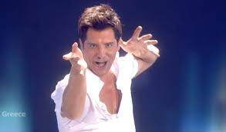
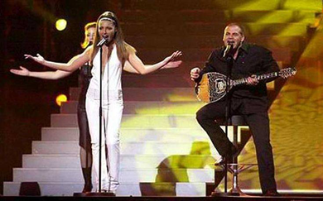





Slide 6
Foreign pop singers
Abel Makkonen Tesfaye known by his stage name The Weeknd is a Canadian singer, songwriter and producer. He has helped expand R&B music by incorporating indie and electronic music.
Michael Jackson : he effectively began his solo career in 1979 with the album Off the Wall. Since then, he has been one of the most commercially successful artists in black music history and one of the most successful solo artists overall in music history.
Elvis Presley: known by the nickname "King of Rock and Roll", he was a singer, musician and actor and is considered by many to be one of the greatest artists of the last 50 years.
Frank Sinatra: american songwriter and actor. During a career spanning from the late 1930s to the mid-1990s, he was one of the most beloved performers in music industry circles. Many consider him the greatest American singer of the 20th century .

Slide 7
Representative songs
My Number One https://g.co/kgs/3WBwBHx
Thriller https://youtu.be/sOnqjkJTMaA?si=qV2AE5oiii-7xr_g

Slide 8
ΠΗΓΕΣ
https://musicpopsongs.weebly.com/omicroniota-kappaalphalambdaupsilontauepsilonrhoomicroniota-kappaalphalambdalambdaiotatauepsilonchinuepsilonsigma-tauetasigma-piomicronpi-omicronlambdaomeganu-tauomeganu-epsilonpio.html
https://el.wikipedia.org/wiki/%CE%A0%CF%8D%CE%BB%CE%B7:%CE%9A%CF%8D%CF%81%CE%B9%CE%B1
THANS FOR THE ATTENTION!!!

