Slide 1
Classical Music eTwinning project LISTEN TO THE RHYTHM
Kyriakos Megaklis
B 2

Slide 2
Classical Music
Classical music generally refers to the art music of the Western world, which is considered to differ from Western folk music or popular musical traditions.
Classical music is often characterized by formality and complexity in its musical form and harmonic organization, particularly with the use of polyphony.

Slide 3
Introduction to the history of classical music
By the ninth century it was primarily a written tradition, giving birth to a sophisticated system of notation, as well as accompanying literature in analytical, critical, historiographical, musicological and philosophical practices.
Fundamental facts of Western civilization , classical music is often seen from the perspective of individuals or groups of composers , whose compositions, personalities and beliefs have fundamentally shaped its history.

Slide 4
Canto Gregoriano - Gregorian Member
With its roots in the protection of churches and royal courts in Western Europe, surviving early medieval music is primarily religious, monophonic and vocal, with the music of ancient Greece and Rome influencing its thought and theory.
The oldest surviving musical manuscripts date from the Carolingian Empire (800–888), around the time when the Western hymnist gradually merged into what is called the Gregorian member.

Slide 5
Secular music
In the early Middle Ages, religious music had a monopoly on any civilizing event. With the crusades, however, the knightly class created its own art, the song of the Troubadours and Trouverians, who wrote lyrics and music.
Their works were usually performed by itinerant musicians, menestrels and jugglers, who had succeeded the ancient itinerant troupes. Their works were usually romantic.

Slide 6
ARS ANTIQUA- Old Art
The first polyphonic efforts of the Paris school from the 9th – 13th centuries are called organum: from the verse of the bible praise the Lord in organs. Guido d'Arezzo, a Benedictine monk, defined the principles of the instrument and perfected the notation.
The “organum” was an improvisation. On a Gregorian member they improvised a second melody, the contre-chant. The 2 voices begin with the same sound (unison), the upper voice rises to the interval of the 4th or even the 5th, the 2 proceed in parallel and finally return to the original sound.

Slide 7
Discantus
The “organum” had no evolution, so in the 12th century a new polyphonic form, the discantus, was created. Bred in France. The 2 voice is placed above the main melody and now moves opposite rather than parallel.
A particular variation of discantus is the false base. Its characteristic is parallel thirds and it was three-voiced.

Slide 8
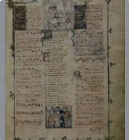
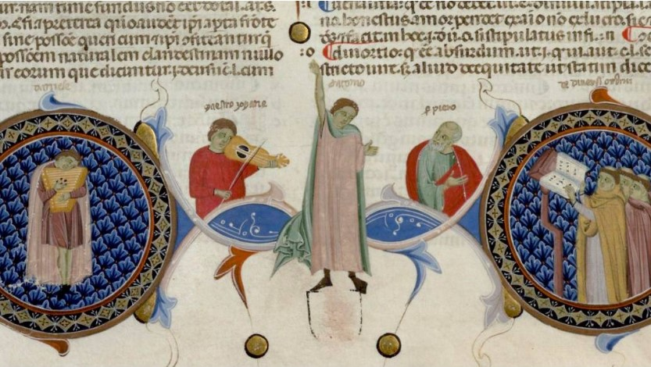
ARS NOVA – New Art
In the 14th century, Philip de Vitry, bishop of Meaux, forbade for the first time the parallel 5th and 8th and generally sought correct rules for composition. Her greatest teacher ars nova is William de Masteau.
Polyphonic forms are motet, rondo, madrigal, ballad and katsia.

Slide 9
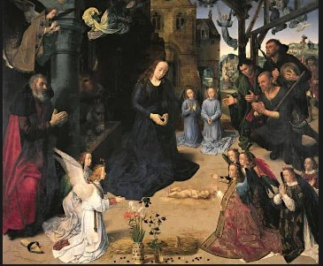
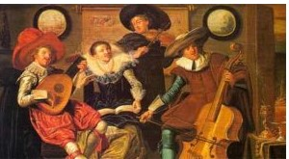
Renaissance
In the 15th century, musical dominance passed to the Franco-Flemish school. Counterpoint (many voices and many melodies) is developed to the highest degree.
In the 16th century, next to them, the Italian school with Palestrina created music a cappella in religious art. Polyphonic vocal music without instrument accompaniment.
The Adoration of the Shepherds, centre panel of the Portinari Altarpiece, by Hugo van der Goes, c. 1474–76;

Slide 10
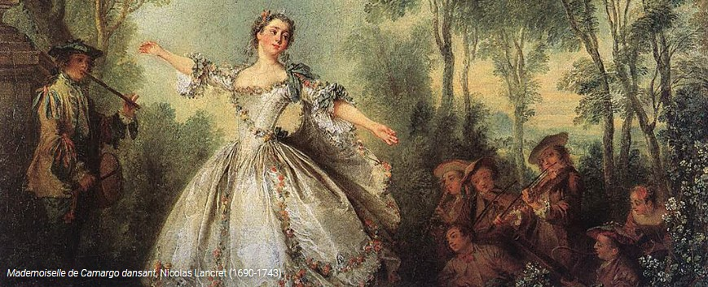
Baroque music
Baroque music is the music that belongs to the general artistic style called Baroque and first developed in Italy in the 17th century and spread throughout Europe.
It is a complex, full, impressive rhythm, in contrast to the calm and serenity that prevailed in the Renaissance, but also organized and coded, without the tedious charge of the 15th century. Baroque art impresses, moves and stimulates the imagination with its wealth of decorations.

Slide 11
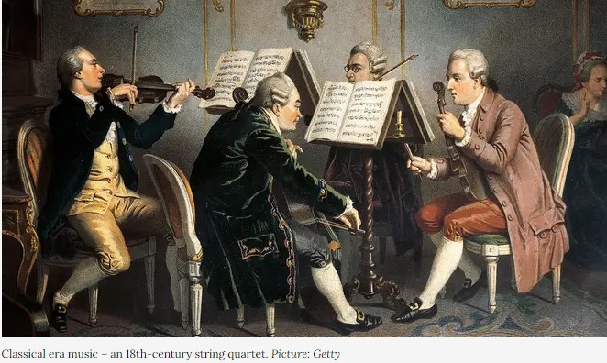
Classical era of music
The classical era of music refers to the classical period of Western music, which began around 1750 and ended between 1810 and 1830. It was the period in which the figures of very important composers such as Joseph Haydn, Wolfgang Amadeus Mozart and Beethoven stood out.
Classical music is generally characterized by a homophonic musical writing in which a basic melody dominates, while the other accompanying parts support this melody. The musical text is most often divided into short periods or phrases while the harmonies alternate at a slower pace. An additional feature of classical music is the alternation of emotions and mood.

Slide 12
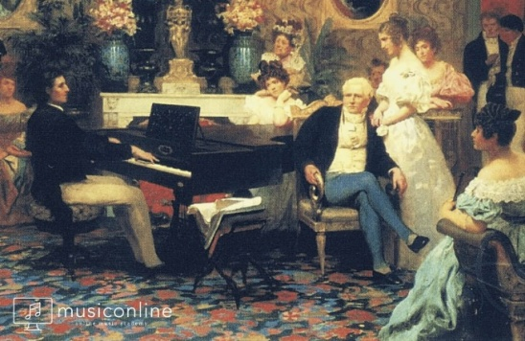
Romantic music
Music belongs to the broader intellectual movement that appeared at the end of the 18th century in Germany and spread during the first decades of the 19th to the rest of Europe. There is a tendency to release emotions that did not exist in previous eras, and artists express pain, love, joy without feeling the need to cover them. Altered chords
Continuous transformations (changes of tonal centers - scales).Exuberance in melodic expression. Rich in timbres orchestrations and numerous orchestras
The scores of the romantics are full of notes on the execution of the work so as not to leave much room for improvisation, while a genre that developed strongly in this period is "Program Music". He tries to depict representations or emotions using the expressive means offered by musical instruments, just as painters use colors.

Slide 13
ΠΗΓΕΣ
https://en.wikipedia.org/wiki/Classical_music
History of music – Karl Nef (book)
History of Music – Emil Wüllermoz (book)
Ars nova, wikipedia
https://www.europeanarsnova.eu/
https://www.britannica.com/event/Renaissance
https://www.musictheoryacademy.com/periods-of-music/renaissance-music/
https://cmbv.fr/en/introducing-baroque/french-baroque-music
https://www.classicfm.com/discover-music/periods-genres/classical/beginners-guide-classical-era-music/
https://musiconline.co/en/blog/the-romantic-period-in-music

